Slide 1
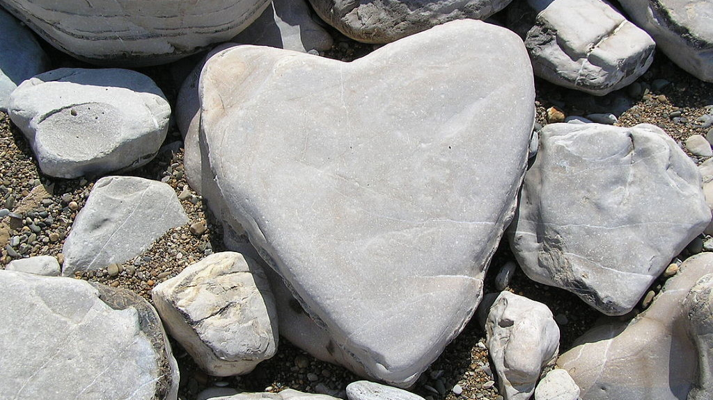
A
Hard
Heart
Hebrews 3
Notes:
Hebrews 3:12-19 AM READING
Introduction:
Hebrew writer extolling the faithfulness of Jesus Christ
(Hebrews 3:1-6), “Therefore, holy brethren, partakers of the heavenly calling, consider the Apostle and High Priest of our confession, Christ Jesus, ² who was faithful to Him who appointed Him, as Moses also was faithful in all His house. ³ For this One has been counted worthy of more glory than Moses, inasmuch as He who built the house has more honor than the house. ⁴ For every house is built by someone, but He who built all things is God. ⁵ And Moses indeed was faithful in all His house as a servant, for a testimony of those things which would be spoken afterward, ⁶ but Christ as a Son over His own house, whose house we are if we hold fast the confidence and the rejoicing of the hope firm to the end.”
This faithfulness of Jesus is differentiated from Moses’ faithfulness
(Establishing both Jesus’ position, and the relative advantage of our relationship to Him (6).
As the church, we are God’s house. We are God’s family.
(Hebrews 3:6), “whose house we are if we hold fast the confidence and the rejoicing of the hope firm to the end.”
(1 Timothy 3:15), “but if I am delayed, I write so that you may know how you ought to conduct yourself in the house of God, which is the church of the living God, the pillar and ground of the truth.”
With such a great blessing comes a great responsibility to serve Him!
Our final standing as a part of this family (and the blessings from it) depend upon our holding fast to the end.
To emphasize this, Hebrews 3 uses Israel in the wilderness as a teaching example.
(A Negative Example). In addition to teaching us to be faithful, he warns against hardening our hearts against God. He also shows how this might come about. Consider the following:
Taken from an article by Joe R. Price
Do Not Harden Your Heart
(Reprint, The Spirit’s Sword, March 3, 2002)

Slide 2

Things That Can Harden our Hearts
Delay
(3:7-8)
Ex: 14:11; 32:1; Num.14:2-4
Ephesians 3:20-21
Notes:
It is possible for our hearts to become hardened because we DELAY our trust and obedience to God
(Hebrews 3:7-8), “Therefore, as the Holy Spirit says: “Today, if you will hear His voice, ⁸ do not harden your hearts as in the rebellion”
Israel was slow to trust and obey God.
Over and over, Israel made trial of God by failing to trust in His power to save and sustain them.
At the Red Sea.
(Exodus 14:11), “Then they said to Moses, “Because there were no graves in Egypt, have you taken us away to die in the wilderness? Why have you so dealt with us, to bring us up out of Egypt?”
At Sinai. Made a golden calf
(Exodus 32:1), “Now when the people saw that Moses delayed coming down from the mountain, the people gathered together to Aaron, and said to him, ‘Come, make us gods that shall go before us; for as for this Moses, the man who brought us up out of the land of Egypt, we do not know what has become of him.’”
At the border of Canaan, desired to return to Egypt.
(Numbers 14:2-4), “And all the children of Israel complained against Moses and Aaron, and the whole congregation said to them, “If only we had died in the land of Egypt! Or if only we had died in this wilderness! ³ Why has the Lord brought us to this land to fall by the sword, that our wives and children should become victims? Would it not be better for us to return to Egypt?” ⁴ So they said to one another, “Let us select a leader and return to Egypt.”
May we not make the same mistake. See the power and presence of God in our lives! Trust and Obey!
(Ephesians 3:20-21), “Now to Him who is able to do exceedingly abundantly above all that we ask or think, according to the power that works in us, ²¹ to Him be glory in the church by Christ Jesus to all generations, forever and ever. Amen.”
If we delay, we may grow tired of calls to faithfulness. Our hearts may grow hard!

Slide 3
Things That Can Harden our Hearts
Doubt
(3:8-9)
Exodus 16:2-3; 17:3
1 Corinthians 1:9
Notes:
It is possible for our hearts to become hardened because we being to DOUBT when a different challenge presents itself
(Hebrews 3:8-9), “Do not harden your hearts as in the rebellion, in the day of trial in the wilderness,
⁹ Where your fathers tested Me, tried Me, and saw My works forty years.”
Though challenged by various trials in the wilderness, God showed Himself faithful time and again. And yet, each time a new trial came to them, they doubted God’s provision.
When they were hungry
(Exodus 16:2-3), “Then the whole congregation of the children of Israel complained against Moses and Aaron in the wilderness. ³ And the children of Israel said to them, “Oh, that we had died by the hand of the Lord in the land of Egypt, when we sat by the pots of meat and when we ate bread to the full! For you have brought us out into this wilderness to kill this whole assembly with hunger.”
God supplied bread from heaven (4) and quails (13)
When they were thirsty
(Exodus 17:3), “And the people thirsted there for water, and the people complained against Moses, and said, “Why is it you have brought us up out of Egypt, to kill us and our children and our livestock with thirst?”
God supplied water from the rock in Horeb (6)
May we not make the same mistake. Let the faithfulness of God in the past give us confidence and hope that he will supply every need in the future!
Do not harden your hearts, doubting God’s love, power or anything else that comes from Him. Build your faith on HIS faithfulness.
(1 Corinthians 1:9), “God is faithful, by whom you were called into the fellowship of His Son, Jesus Christ our Lord.”

Slide 4
Things That Can Harden our Hearts
Deceitfulness
of
Sin
(3:13)
Exodus 16:3; 32:4
Reference
Notes:
It is possible for our hearts to become hardened because we are deceived by Sin!
(Hebrews 3:13), “but exhort one another daily, while it is called “Today,” lest any of you be hardened through the deceitfulness of sin.”
The children of Israel continually were tempted to return to material comfort and false Gods in Egypt!
Fleshpots of Egypt (Materialism) KJV Note: not only doubted God would care for them, but longed for (preferred) the carnal rather than their spiritual relationship with God.
(Exodus 16:3), “And the children of Israel said to them, “Oh, that we had died by the hand of the Lord in the land of Egypt, when we sat by the pots of meat and when we ate bread to the full! For you have brought us out into this wilderness to kill this whole assembly with hunger.”
The idolatry of Egypt
(Exodus 32:4), “And he [Aaron] received the gold from their hand, and he fashioned it with an engraving tool, and made a molded calf. Then they said, “This is your god, O Israel, that brought you out of the land of Egypt!”
May we not make the same mistake. Sin deceives. What we think will benefit brings antagonism from God, and spiritual death!
(James 4:4), “Adulterers and adulteresses! Do you not know that friendship with the world is enmity with God? Whoever therefore wants to be a friend of the world makes himself an enemy of God.”
(Romans 6:23), “For the wages of sin is death, but the gift of God is eternal life in Christ Jesus our Lord.”
Sin will not lead you to the promised land!

Slide 5
Things That Can Harden our Hearts
Disobedience
(3:15-19)
Numbers 14:6-10
Reference
Notes:
It is possible for our hearts to become hardened because of Disobedience
(Hebrews 3:15-19), “while it is said: “Today, if you will hear His voice, do not harden your hearts as in the rebellion.” ¹⁶ For who, having heard, rebelled? Indeed, was it not all who came out of Egypt, led by Moses? ¹⁷ Now with whom was He angry forty years? Was it not with those who sinned, whose corpses fell in the wilderness? ¹⁸ And to whom did He swear that they would not enter His rest, but to those who did not obey? ¹⁹ So we see that they could not enter in because of unbelief.”
Notice here that Israel’s disobedience was equated to unbelief! (they go hand in hand)
God commanded them to enter the land, and they would not!
(Numbers 14:6-10), “But Joshua the son of Nun and Caleb the son of Jephunneh, who were among those who had spied out the land, tore their clothes; ⁷ and they spoke to all the congregation of the children of Israel, saying: “The land we passed through to spy out is an exceedingly good land. ⁸ If the Lord delights in us, then He will bring us into this land and give it to us, ‘a land which flows with milk and honey.’ ⁹ Only do not rebel against the Lord, nor fear the people of the land, for they are our bread; their protection has departed from them, and the Lord is with us. Do not fear them.” ¹⁰ And all the congregation said to stone them with stones. Now the glory of the Lord appeared in the tabernacle of meeting before all the children of Israel.”
Each time we disobey God, it makes it easier to do so the next time. This is the hardening of the heart.
We can even reach the point where we are no longer reached by God!
(2 Peter 2:10-21), “For if, after they have escaped the pollutions of the world through the knowledge of the Lord and Savior Jesus Christ, they are again entangled in them and overcome, the latter end is worse for them than the beginning. ²¹ For it would have been better for them not to have known the way of righteousness, than having known it, to turn from the holy commandment delivered to them.”

Slide 6
Do Not
Harden
Your
Heart!
Hebrews 4:1, 11
Notes:
Remember, God has promised you rest. Do not harden your heart.
(Hebrews 4:1), “Therefore, since a promise remains of entering His rest, let us fear lest any of you seem to have come short of it.”
(Hebrews 4:11), “Let us therefore be diligent to enter that rest, lest anyone fall according to the same example of disobedience.”
(Reprint, The Spirit’s Sword, March 3, 2002)

